Slide 1

Introduction to OS
PASS
CS532: OS Foundations
Lab Assignment
Email: chitram2@pdx.edu

Slide 2
Instructions: Make a copy of this document, move your copy to your submissions folder and fill the document with your responses. Use the space on each slide to show your responses, and add additional slides as needed.
When ready for grading: complete the lab assignment submission form and include a link to your filled document

Slide 3
1. Which operating systems have you used prior to this class? List as many as you can think of.
Microsoft windows
Mac os
Linux
Android

Slide 4
2. Compile and run the mytest.c program and run three concurrent copies of it as shown in the lecture video. use the "jobs" command to list the running mytest processes, and use the "kill" command to terminate them. Take a screenshot of the result and paste into the follow slide.
Answer:
For compiling the program,
gcc -Werror -Wall mytest.c -o mytest
For running three concurrent copies of the program,
./mytest goodbye & ./mytest farewell & ./mytest so_long &
Jobs command will list running processes and kill with the proper argument will kill the process. The screenshots is below

Slide 5
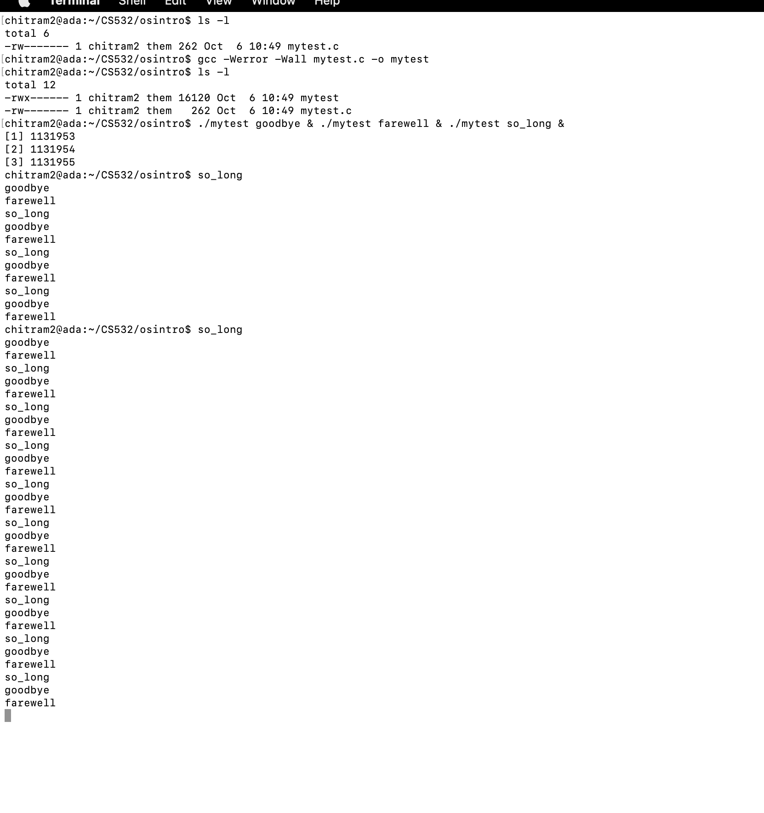
Screenshot(s) for #2
Compilation and running three concurrent copies of the process

Slide 6
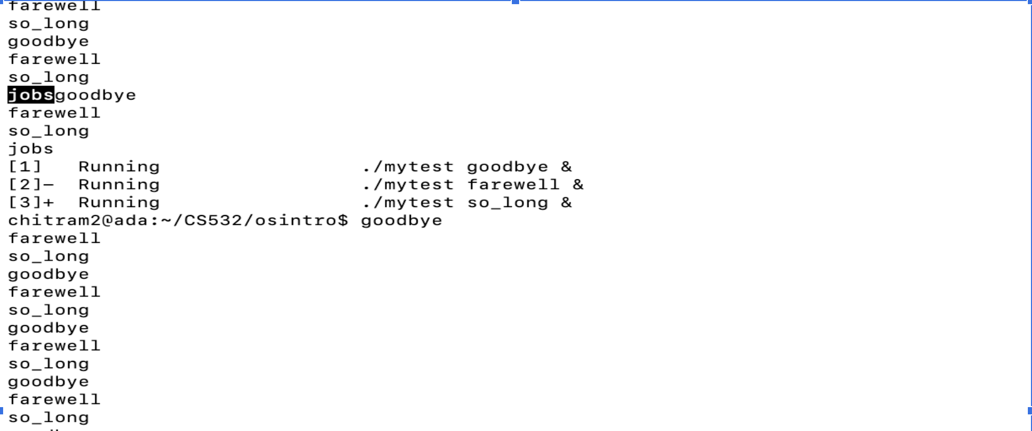
2) Job command to list the running mytest processes
Good

Slide 7
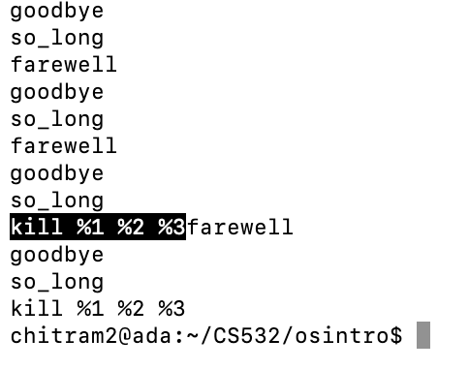
3) kill command to terminate these processes

Slide 8
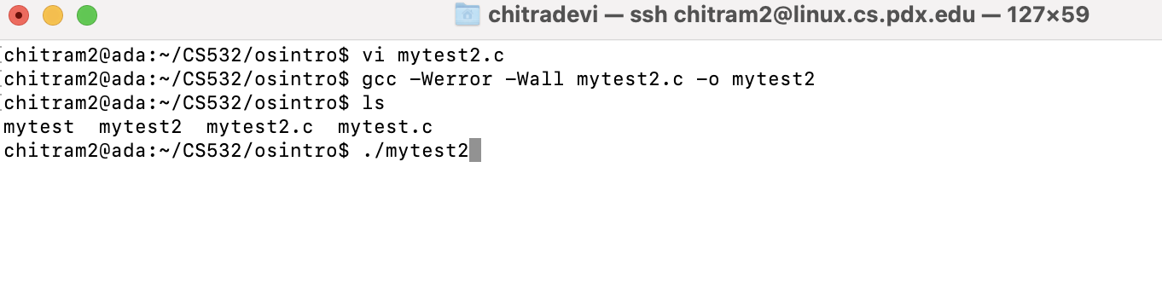
3. Compile and run the mytest2.c program as shown in the lecture slides. Run it until it crashes with a "Segmentation Fault". What is a segmentation fault?
1)Compilation screen and run command for mytest2.c program

Slide 9
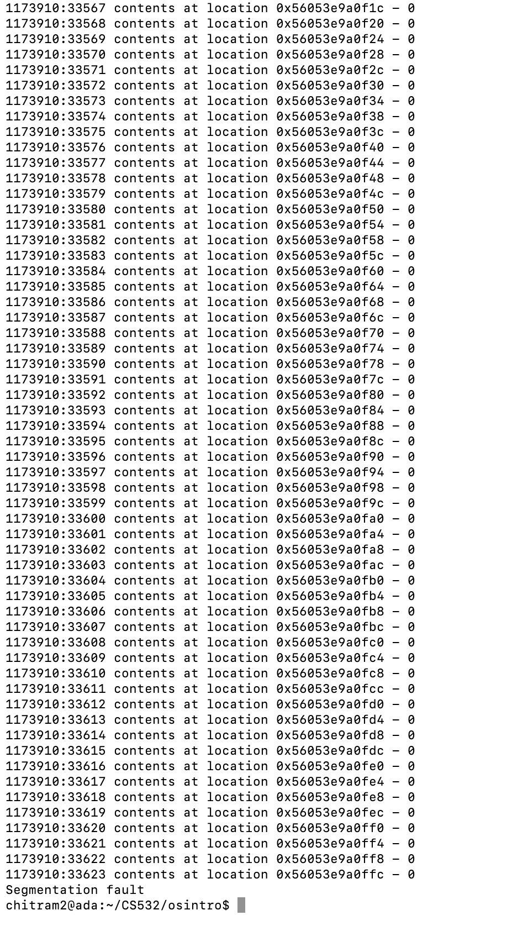
2)Running the Compiled mytest2.c program and segmentation fault screen

Slide 10
Segmentation Fault:
Good
Segmentation Fault is a program crash which occurs when program that attempts to access the memory location that it is not supposed to access and has not been allocated to the program by resource manager.
It also occurs when a code tries to perform a write operation in a read only memory location.
It can also occur when there is a memory corruption due to illegal use of String literals or illegal use of pointers in C/C++.
This part of the response is just a special case of the previous part of the response. “Illegal use of pointers” is a segmentation fault if/when the use attempts to access a memory location that the process is not supposed to access

Slide 11
4. Describe how you might fix the two bugs in the mytest2.c code.
Answer:-
The below code is needed to check if all memory on the computer had been allocated previously.
if (p == 0){
printf("error - out of memory");
return 1;
}
2) If malloc does not return null, then it executes do-while loop. But the while loop should be i<10.
while (i<10)
Looks good now. We always need to check to make sure that malloc() returned a valid pointer

Slide 12
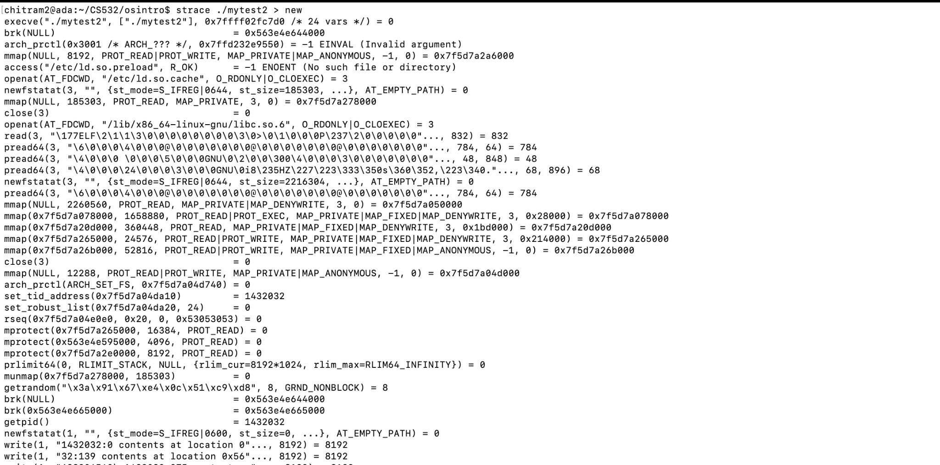
5. One of the most useful OS skills you can learn is to trace system calls for a program. On our department's linux servers you can use the "strace" program to trace all of the OS system calls called by a program. Use the strace program to trace all system calls called by the ./mytest2 program. Do it like this: "strace ./mytest2" This command will cause strace to run the ./mytest2 program AND trace all of the system calls called by ./mytest2. Collect the names of all of the system calls listed by strace and the number of times each syscall is called. Then use "man 2 <syscallname>" to get a one line description of each syscall. Record your results in the table on the following slide. Add extra rows/pages as needed.

Slide 13
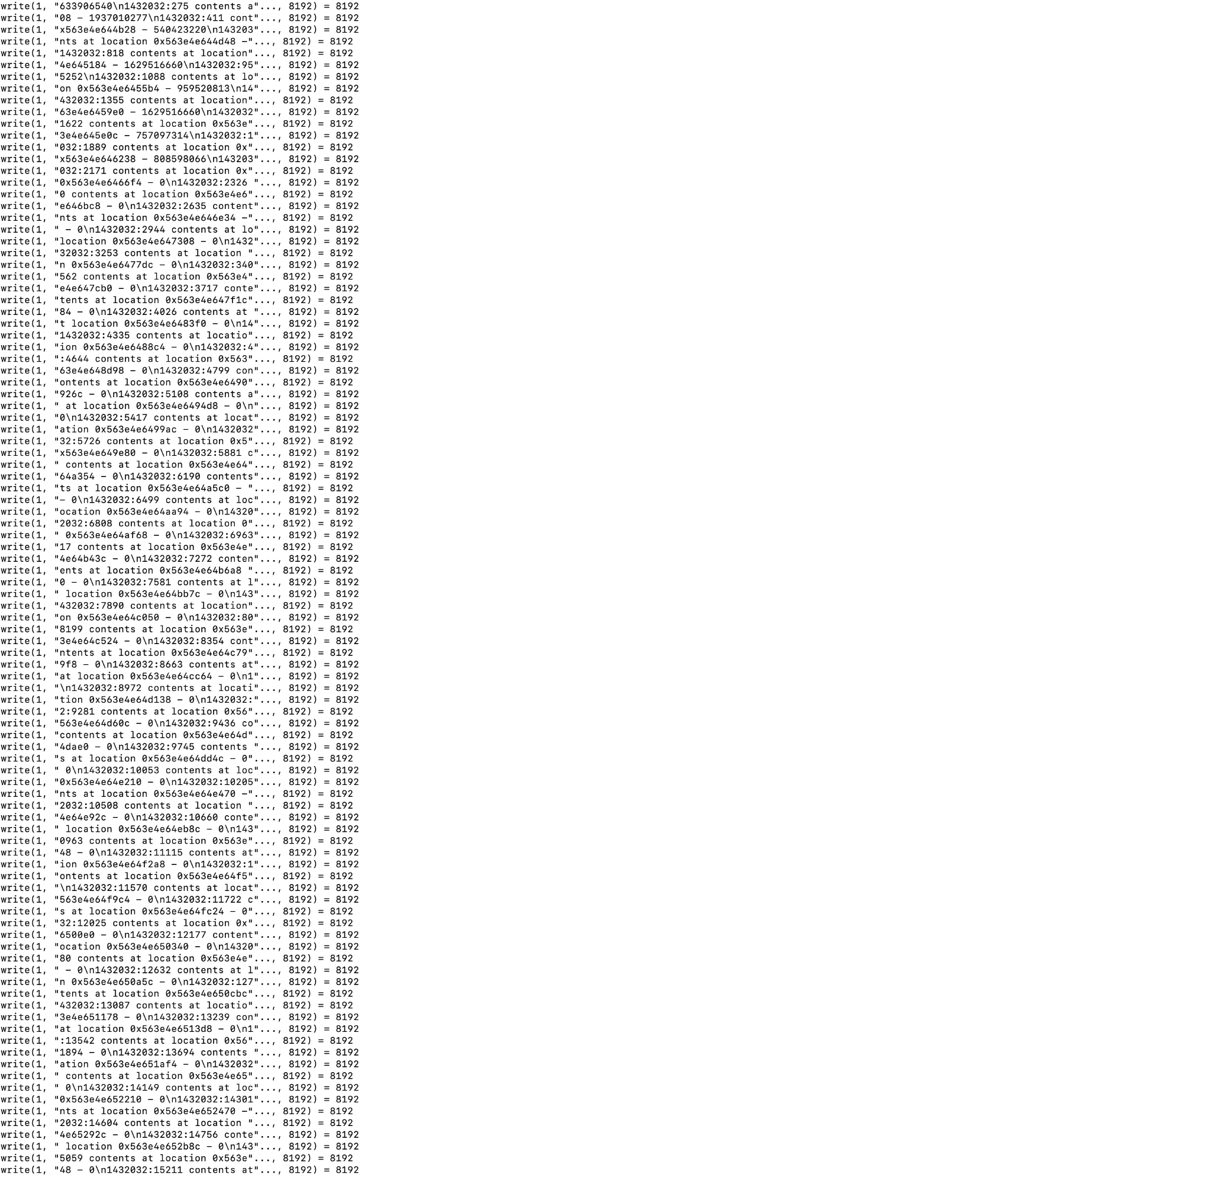

Slide 14
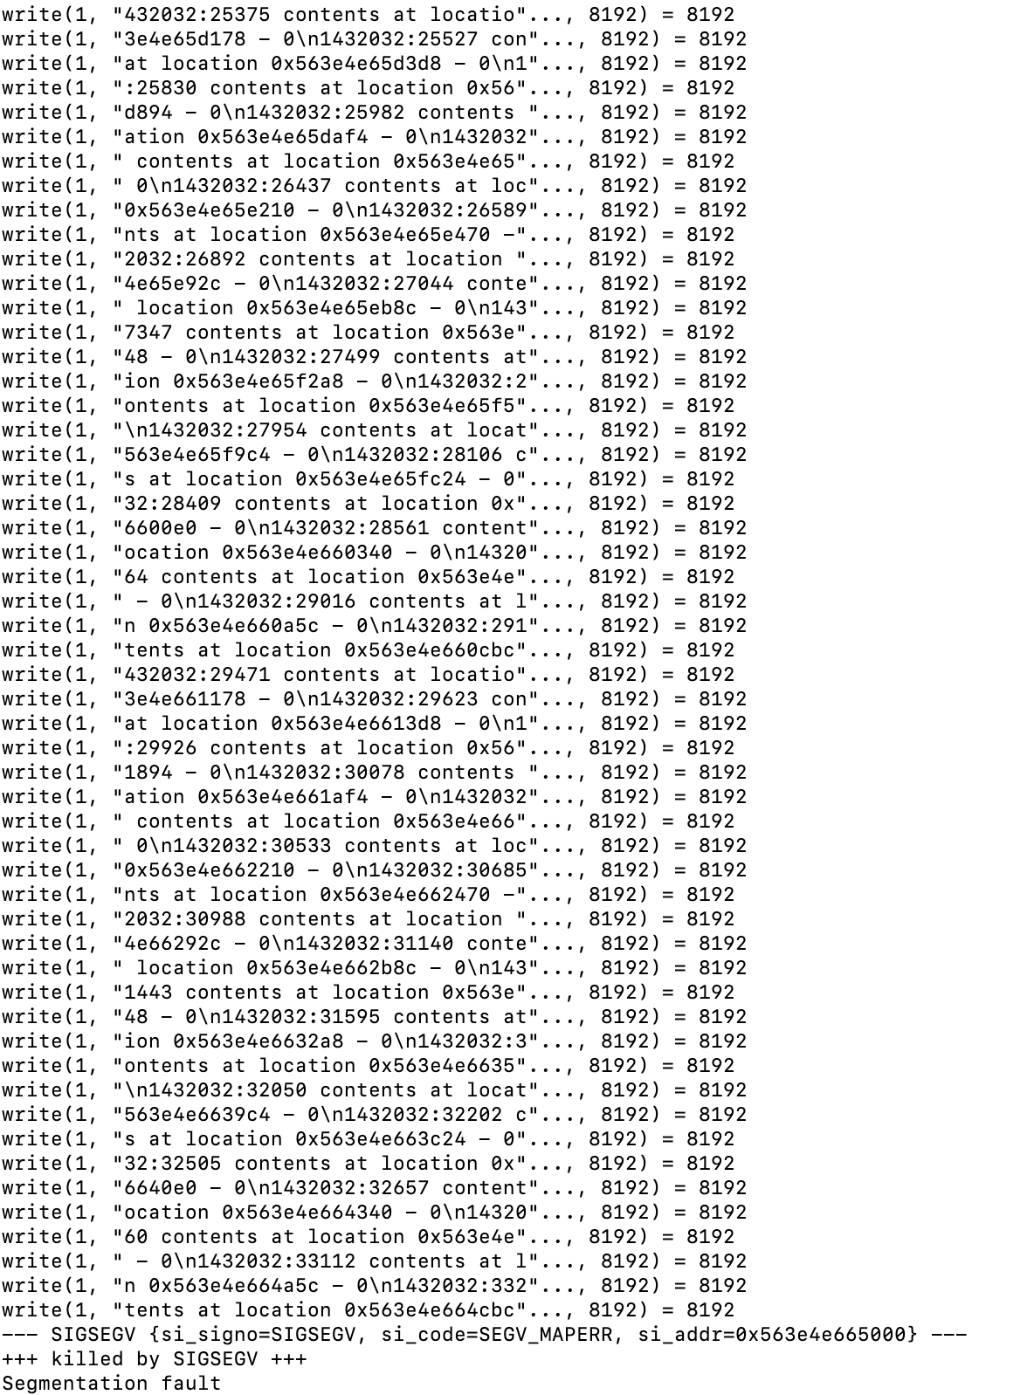

Slide 15
Traced System Calls for #5
syscall name | One line description of this syscall | count
execve | execve() executes the program referred to by pathname. This causes the program that is currently being run by the calling process to be replaced with a new program, with newly initialized stack, heap, and (initialized and uninitialized) data segments. | 1
brk | brk() and sbrk() change the location of the program break, which defines the end of the process's data segment (i.e., the program break is the first location after the end of the uninitialized data segment). Increasing the program break has the effect of allocating memory to the process; decreasing the break deallocates memory. | 3
arch_prctl | arch_prctl() sets architecture-specific process or thread state. code selects a subfunction and passes argument addr to it; addr is interpreted as either an unsigned long for the "set" operations, or as an unsigned long *, for the "get" operations. | 2
access | access() checks whether the calling process can access the file pathname. If pathname is a symbolic link, it is dereferenced. | 1

Slide 16
syscall name | One line description of this syscall | count
openat | The open() system call opens the file specified by pathname. If the specified file does not exist, it may option ally (if O_CREAT is specified in flags) be created by open(). | 2
fstat | fstatat() retrieve information about the file pointed to by pathname. fstat() is identical to stat(), except that the file about which information is to be retrieved is specified by the file descriptor fd. | 3
mmap | mmap() creates a new mapping in the virtual address space of the calling process. The starting address for the new mapping is specified in addr. The length argument specifies the length of the mapping (which must be greater than 0). | 7
close | close() closes a file descriptor, so that it no longer refers to any file and may be reused. Any record locks (see fcntl(2)) held on the file it was associated with, and owned by the process, are removed (regardless of the file descriptor that was used to obtain the lock). | 2

Slide 17
syscall name | One line description of this syscall | count
read | read() attempts to read up to count bytes from file descriptor fd into the buffer starting at buf. On success, the number of bytes read is returned (zero indicates end of file), and the file position is advanced by this number. | 1
pread64 | pread() reads up to count bytes from file descriptor fd at offset offset (from the start of the file) into the buffer starting at buf. The file offset is not changed. | 6
mprotect | mprotect() changes the access protections for the calling process's memory pages containing any part of the address range in the interval [addr, addr+len-1]. addr must be aligned to a page boundary. If the calling process tries to access memory in a manner that violates the protections, then the kernel generates a SIGSEGV signal for the process. | 4
getpid | getpid() returns the process ID (PID) of the calling process. (This is often used by routines that generate unique temporary filenames.) | 1

Slide 18
syscall name | One line description of this syscall | count
write | write() writes up to count bytes from the buffer starting at buf to the file referred to by the file descriptor fd. | 222
munmap | munmap() removes any mappings for those entire pages containing any part of the address space of the process starting at addr and continuing for len bytes | 1
Good

